Slide 1
Guide to Access Control Systems

Slide 2
What is an access control system?
An access control system allows you to manage, monitor and maintain who has access to for example your doors.
Using an access control system allows you to manage access or entry to almost anything: file access, workstation access, printer access and in our case, door, facility, building or office access. The standard form of today’s access control is an “access card” to grant access to the secured area.

Slide 3
Challenges of Traditional Access Control
Often requires VPN configuration
Labor-intensive provisioning and de-provisioning process
No easy way to tell if devices are correctly working
Insecure protocols (e.g. Wiegand)
5. Fragmented system design is difficult to update and maintain
6. Single point of failure (local server)
7. Insecure practices (password sharing, credential cloning)

Slide 4
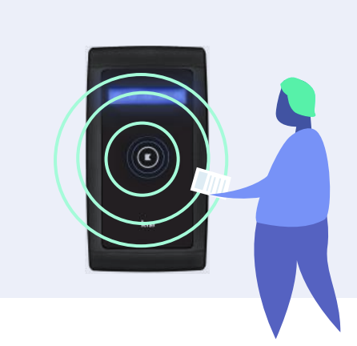
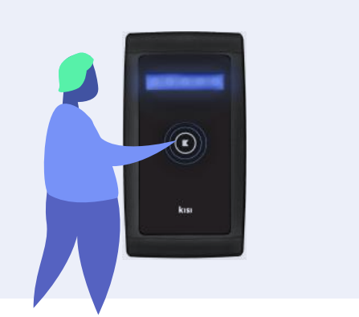
Basic Components of Access Control
User-facing
Admin-facing
Infrastructure
Mobiles, access cards, card reader and access control keypad
Access management dashboard, integrations or API
Electric door lock hardware, access control panels, access control server computer and low voltage cabling

Slide 5
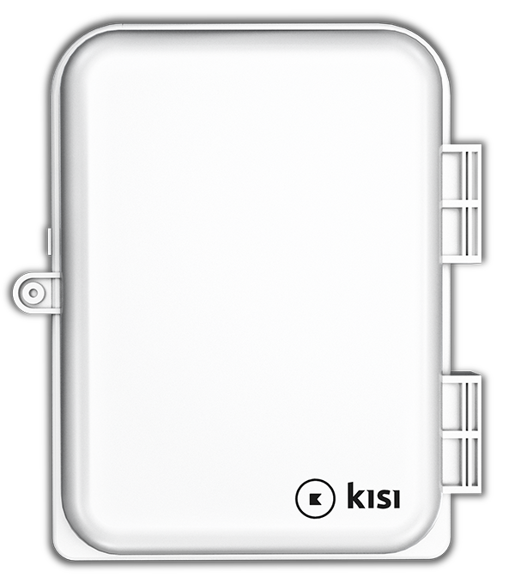
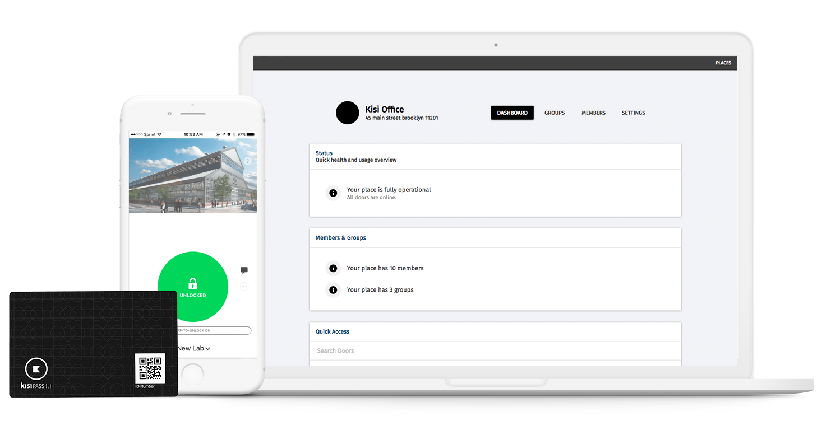
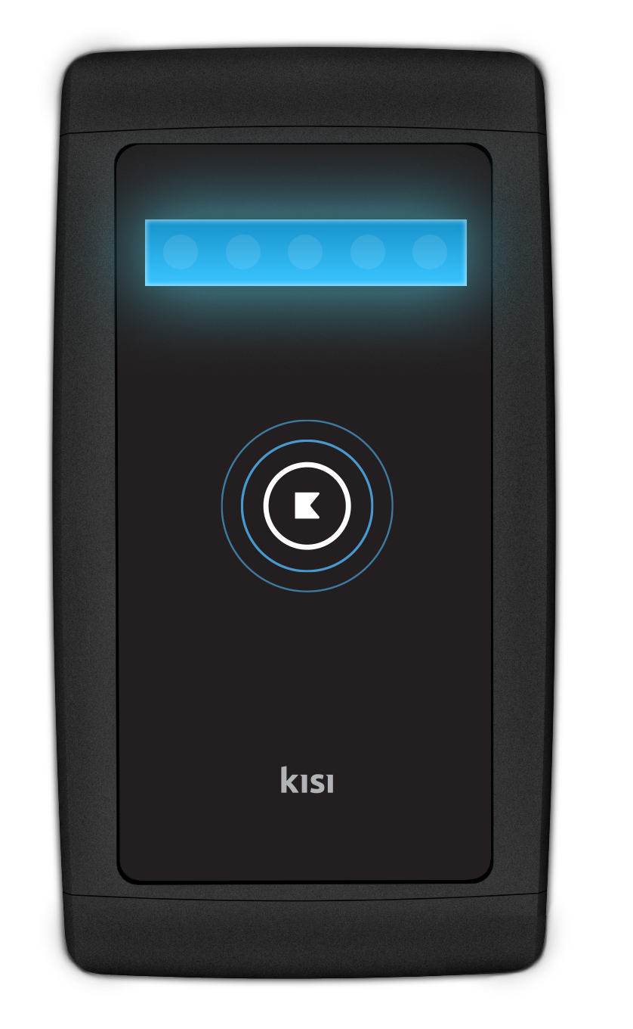
Team
Mission
Vision
Create a full stack door access control that is easy to set up, scale and operate.
To be a secure and scalable physical security platform for AI applications.
Founded in 2012 by a team of Columbia and Stanford cloud specialists.

Slide 6
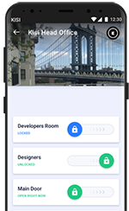
IT-centric Door Access
No local server. No insecure standards.
No old firmware.
Controller
Mobile (BLE & NFC) access
NFC smart cards (128bit AES)
Smart door controls
PoE Reader (BLE & NFC)
Scalability (1-X devices)
Industrial grade
Local cache
Remote manage-able
Cloud management
Works with any wired locks
Integration in IT
Every device, every site,
worldwide -- anytime
Provide secure, audited access to door access

Slide 7
At A Glance
All-in-One System
- No local server, scales easily
- Automatic firmware updates
- PoE based readers
- On-board power for locks
- Local cache on each device
End-to-end encryption
- At rest: AES
- In transit: HTTPS / SSL
- Devices directly connected to firewall
Easy, 24/7 access
- User friendly cloud software
- Unlimited users
- No SDK’s

Slide 8
Built for Enterprise Scale and Simplicity
Secure
- Encryption at Rest (AES)
- In Transit (HTTPS, SSL)
- 2FA for Mobile
- Detailed Audit Logs in Real Time
- Automatic Firmware Updates
Smart
- Secure Remote Access
- Active Monitoring & Smart Alerts
- On-demand access sharing
- Heatmap Following Usage Patterns
Scalable
- Scalable to Unlimited Devices
- Not Dependent on Local Server
- Fast Deployment
- Scalable User Permissions and Controls

Slide 9
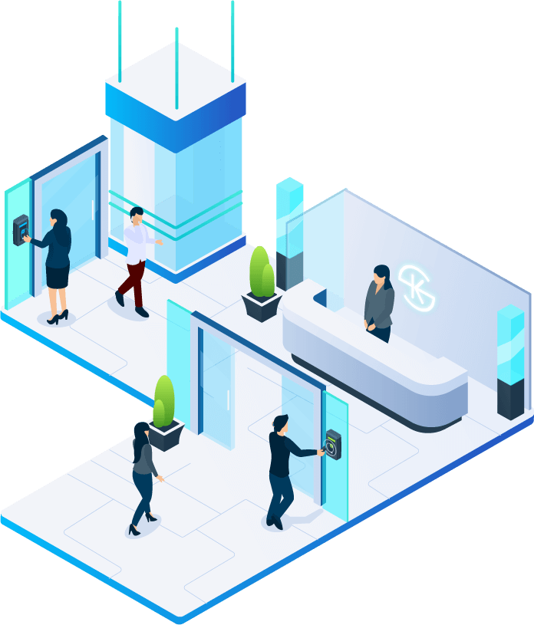
Typical Client Situations
1
Unify Access Control
No local differences
Enable all employees
Support growth or change
→ Standardize security in facility premises
2
Streamline Operations
Have a fast and easy set-up
Remote management
Employee enablement
→ Use technology to enable business
3
Achieve Standards
Directory integration
2FA, Single Sign On
Data analysis
→ Become compliant in physical access control

Slide 10
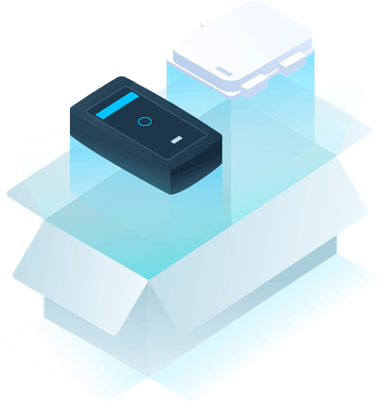
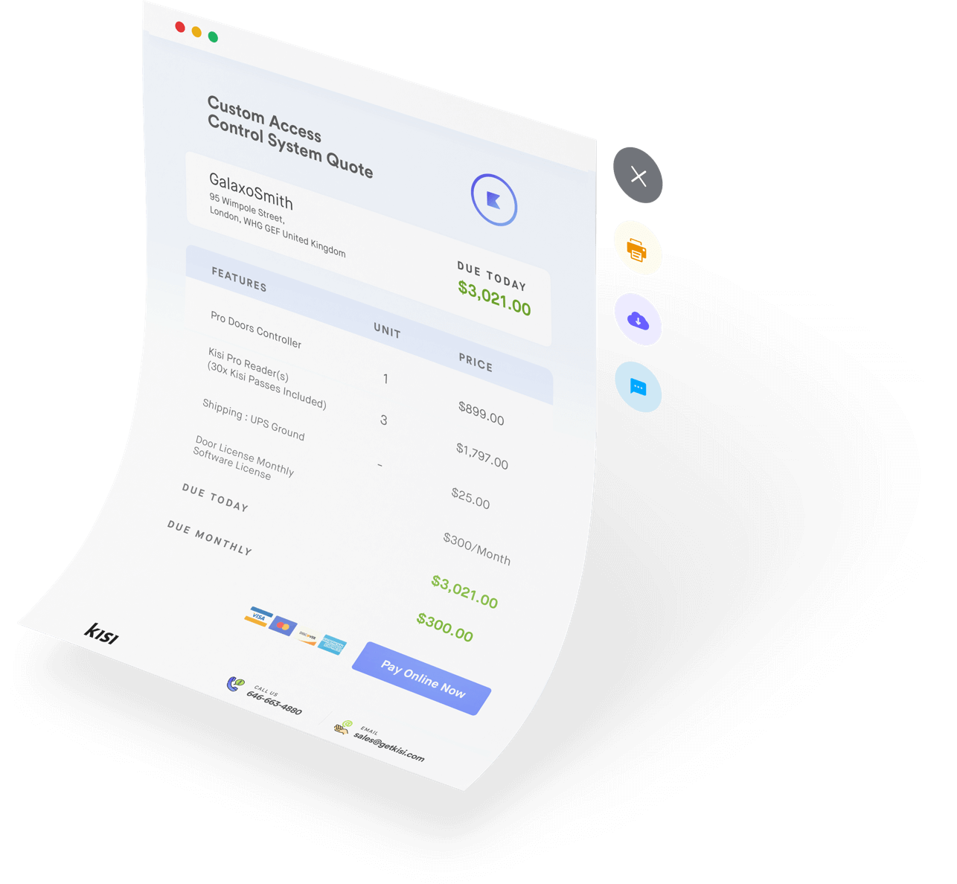
How to Evaluate, Buy and Implement Kisi
1
2
3
Deploy Proof of Concept (POC)
Technology validation
Management approval
Employee testing
Calculate Unit Cost
Kisi hardware incl license
Installation price, schedule site inspection
Project Plan
Timeline
Involved contacts
Door schedule

Slide 11
Get A Demo.

